Slide 1
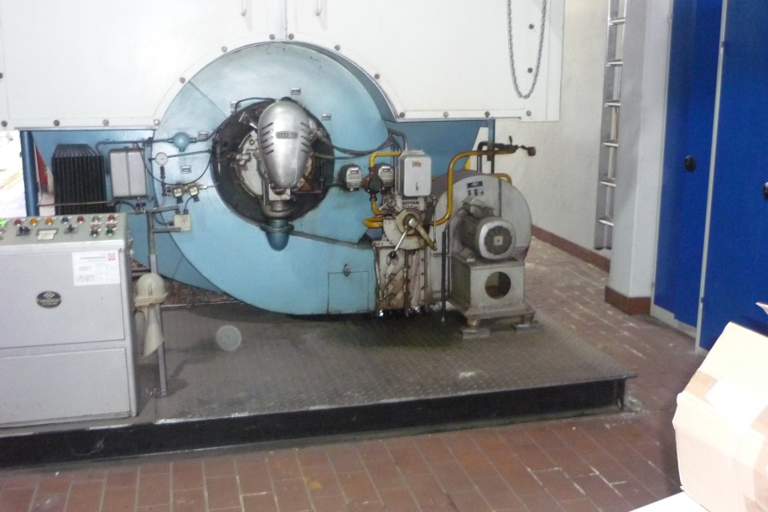
HS&E INCIDENT BULLETIN |  | 2nd half year 2014
Germany | Type of incident - Slip/Trip/Fall
Summary:
The employee was performing visual control of a valve on a steam boiler. To do so, he had to step onto a baseplate in front of the boiler. He stepped backwards from the platform when standing near the edge, lost his balance and fell on the floor. He stopped his fall with his left arm and hand. The employee was found to have a broken wrist and had surgery the same day
Root Causes: | Actions Taken Thus Far: Next Steps
Restricted space on baseplate | Mark steps with yellow/black tape

